Slide 1
Tax Payments Made & Credits
Pub 4012 Tab H
Pub 17 Chapter 4
(Federal 1040-Lines 64-74)
(NJ 1040-Lines 48 & 50)
Notes:
1

Slide 2
Types of Payments & Credits
Can be applied against tax liability
Federal and NJ
Income tax withheld from W-2s, W-2Gs, 1099s, etc.
Estimated tax payments
Amounts applied from prior year’s return
Payments made with a request for extension of time to file
Earned income credit
Federal Only
Additional child tax credit
Refundable American Opportunity credit
NJ Only
Property Tax Credit
Excess UI / DI / FLI
Notes:
2

Slide 3
Income Tax Withholding – 1040 Line 64 / NJ-1040 Line 48
Collected by employer
Set aside from pensions, Social Security
Set aside from bonuses, commissions
Set aside from gambling winnings
TW – automatically totals from data entry on individual forms & populates on 1040 Line 64 or NJ-1040 Line 48
Notes:
3

Slide 4
Estimated Tax Payments – Federal 1040 Line 65 / NJ-1040 Line 50
Means of payment for:
Self-employed
Those with investment income
Projected Federal balance due > $1,000
Taxpayers with NJ projected balance due > $400 should file NJ estimated tax payments
Payments made periodically by taxpayer (usually due on 4/15, 6/15, 9/15 and 1/15 of subsequent year)
Need to know “When” & “How Much” for each 2014 estimated tax payment made
Estimated tax payments are made separately from tax return
Particularly important for payment due 4/15
Notes:
4

Slide 5
Overpayment From Previous Year
Could have elected to have 2013 refund applied to 2014 tax liability
Ask taxpayer if 2013 refund was applied to 2014 taxes or check 2013 tax return
TW will bring forward 2013 Federal refund applied to 2014 taxes if carry-forward data was loaded
TW will not bring forward 2013 NJ refund applied to 2014 taxes. Must manually enter on F/S Tax Paid screen
Notes:
5

Slide 6
Estimated Tax Payments Example Davis Family
The Davis family made the following Federal estimated tax payments:
On 04/12/2014 tax payment of $250
On 06/11/2014 tax payment of $250
On 09/15/2014 tax payment of $250
On 01/05/2015 tax payment of $250
The Davis family did not choose to apply any of last year’s refund to this year’s tax liability
Notes:
6

Slide 7
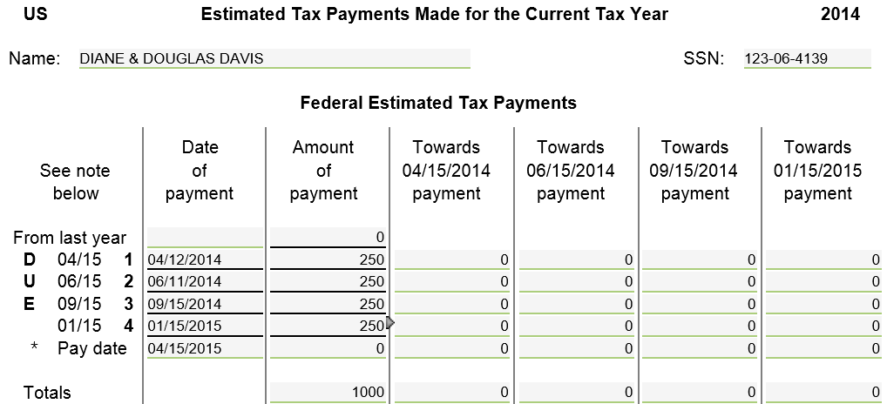
TW - Federal Estimated Tax Payments
From prior year return
From taxpayer
Notes:
Pull up F/S Tax Paid screen
Link from 1040 Page 2 Line 63 (using arrow or F9) OR
Go directly to Estimated Tax Payments screen by clicking on F/S Tax Pd in Forms Tree. If not in tree, click on Forms List icon & type “F/S Tax Paid.” TW will add to Tree
Enter federal data:
Refund from 2013 that was applied to 2014
If carry-forward data from 2013 was loaded for taxpayer, TW will populate amount of 2013 refund applied to 2014 estimated taxes automatically. Otherwise, get amount from 2013 1040 Page 2 Line 75
Actual dates & amounts of 2014 estimated tax payments made
TW populates due dates of estimated tax payments – 4/15/2014, 6/15/2014, 9/15/2014, 1/15/2015
Change dates, if necessary, to actual dates that payments were made
7

Slide 8
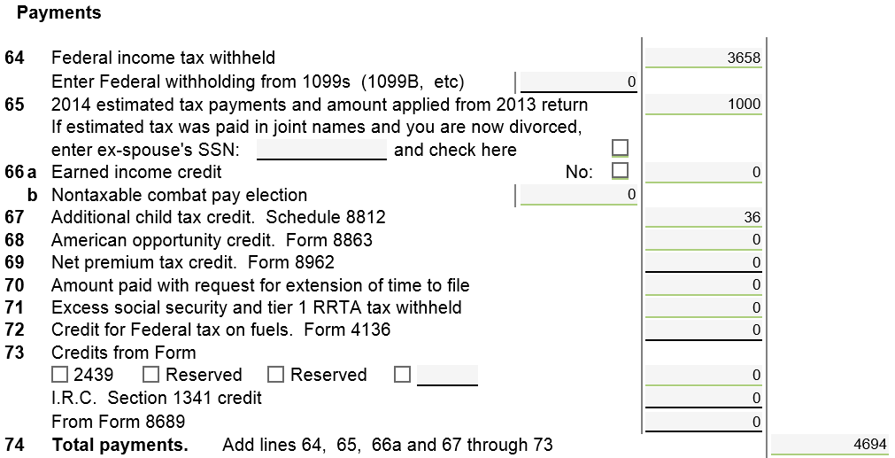
TW Federal 1040 Line 65 – Federal Estimated Taxes Paid
TW transfers from F/S Tax Paid screen
Notes:
TW will transfer total of last year’s refund applied to current year + federal estimated tax payments to 1040 Page 2 Line 65
8

Slide 9
NJ Tax Payments on F/S Tax Paid Screen
State section of F/S Tax Paid screen captures numerous types of NJ tax payments
2014 NJ estimated tax payments paid in 2014 or January 2015
2013 (& prior years) tax payments paid in 2014 *
Many clients paid a balance due when they filed 2013 tax return at the beginning of 2014
Final 2013 estimated tax payment made in January 2014
Refund from 2013 tax return applied to 2014 *
* Does not pertain to estimated taxes, but still entered on F/S Tax Paid screen
Notes:
F/S Tax Paid screen is not just for estimated tax paid
Also captures 2013 balance due paid in 2014
Also captures 2013 refund applied to 2014 tax liability
9

Slide 10
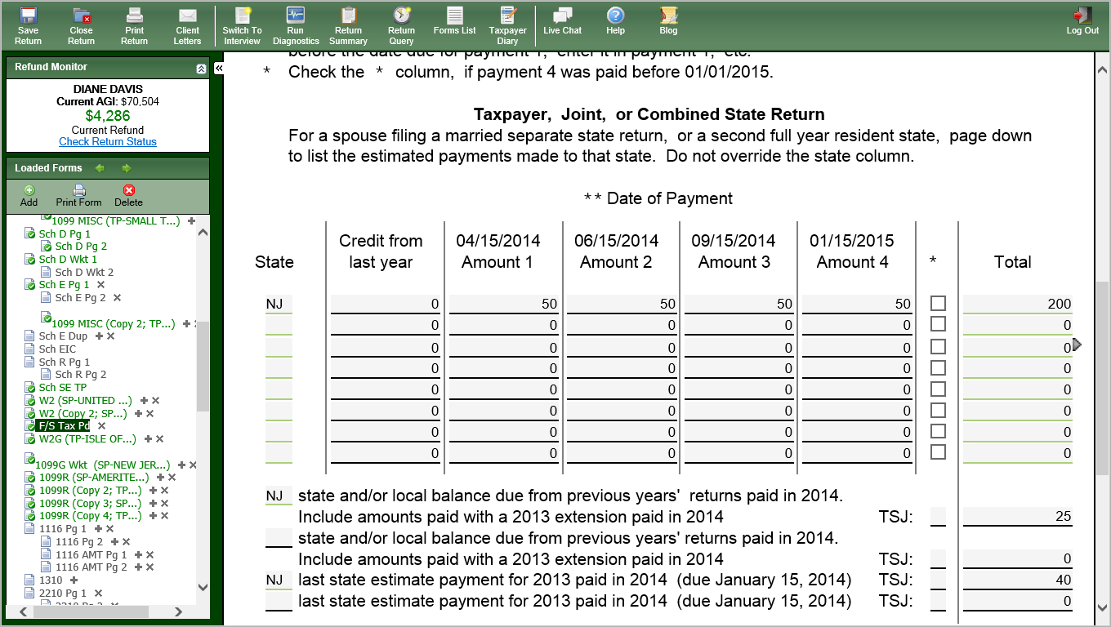
TW – NJ Tax Payments
1/15/2015 payment paid in 2014
From 2013 return
NJ estimated tax payments
Balances from prior year(s) paid in 2014
Final 2013 estimate payment paid in 2014
Notes:
Enter NJ data: Capturing all NJ tax payments associated with 2014 tax return
Refund from 2013 NJ return that was applied to 2014 tax liability
TW does not automatically populate amount of 2013 NJ refund applied to 2014 estimated taxes when it loads carry-forward data. Get amount from 2013 NJ1040 Page 3 Line 58 and manually enter
2014 estimated tax payments made
Check box with * if final estimated tax payment due 1/15/2015 was paid in 2014 (if you forget when to check asterisk box, instructions at top of NJ section)
Balance due from previous years’ return paid in 2014 – don’t forget to look for this even if taxpayer did not pay estimated tax
Final 2013 estimated tax payment due on 1/15/2014, if paid in 2014
10

Slide 11
NJ Estimated Tax Payments: What Amounts Are Transferred Where
Sch A Line 5a State & Local Taxes includes payments made in current tax year for any year’s tax due :
2014 estimated tax payments paid in 2014
2013 (or prior) tax payments paid in 2014*
Final 2013 estimated tax payment paid in January 2014
Refund from 2013 return applied to 2014
NJ 1040 Line 50 includes payments applied to current year’s tax due, no matter when paid:
2014 estimated tax payments paid in 2014 or 2015
Refund from 2013 return applied to 2014
* Client may have paid balance due on 2013 return in 2014. Look for this even if no estimated taxes paid
Notes:
11

Slide 12
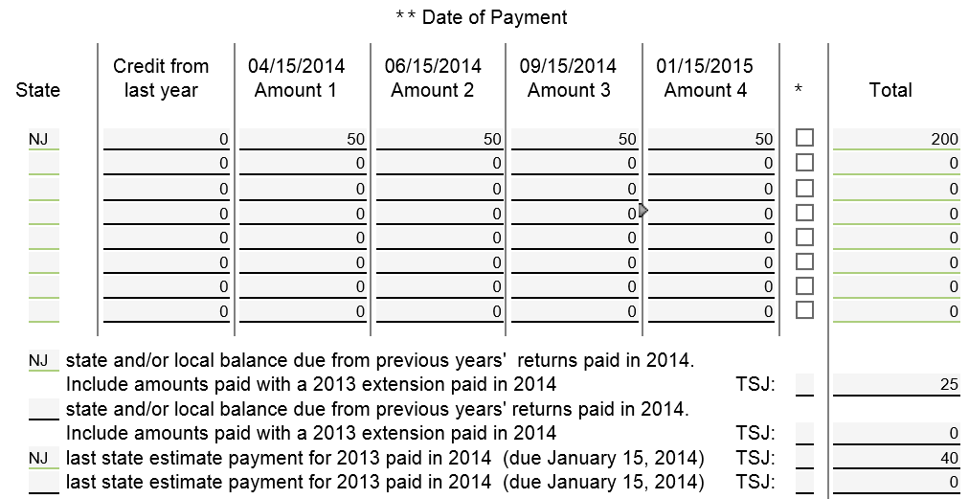
TW F/S Tax Paid Screen – Sch A Amounts (Amounts Paid in 2014)
TW totals & transfers to Schedule A Line 5a
Box not checked since final payment not made before 1/1/2015; TW will not include final payment in amounts paid in 2014
Notes:
TW totals all NJ taxes paid in current tax year from F/S Tax Paid screen & populates on Schedule A Line 5a State/Local Taxes Paid
12

Slide 13
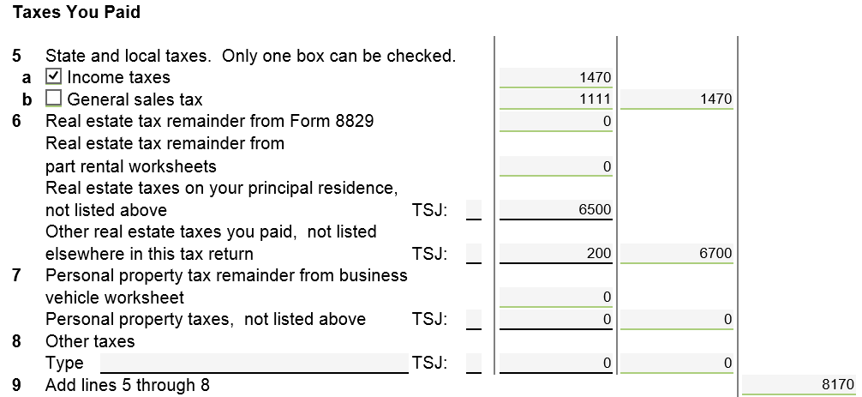
TW Sch A Line 5a State & Local Taxes
TW includes amount from F/S Tax Paid screen
Also includes taxes from W-2, W-2G, 1099s
Notes:
13

Slide 14
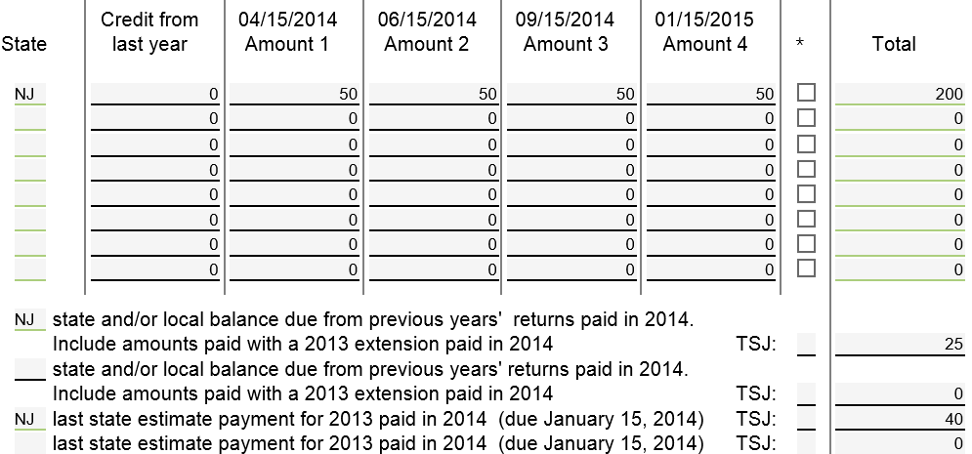
TW F/S Tax Paid Screen – NJ 1040 Amounts (Amounts Applied to 2014 NJ Taxes)
TW totals & transfers to NJ 1040 Line 50
Even though final payment was made in 2015, it is for 2014 NJ taxes; TW will include in total amount applied to 2014 NJ Taxes
Notes:
14

Slide 15
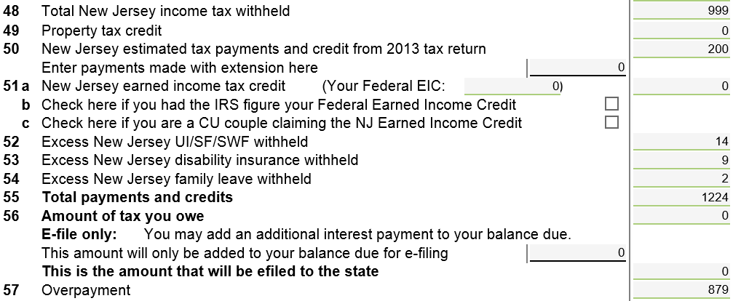
TW NJ 1040 Line 50 - NJ Estimated Tax Payments & Credit from 2013 Return
TW transfers from F/S Tax Paid screen
Notes:
Summary:
For Federal return: Taxes paid are anything paid in current tax year
For NJ return: Taxes paid are taxes pertaining to current tax year, regardless of when they are paid
15

Slide 16
Estimated Tax Payments – TW Tips
Link to F/S Tax Paid Worksheet from 1040 Line 65 or click on F/S Tax Paid in Forms Tree
Federal information
Enter Refund from 2013 applied to 2014 estimated taxes (from 2013 1040 Line 75) into box “From last year”
Report dates & amounts of 2014 estimated tax payments
NJ information
Enter date & amounts of NJ 2014 estimated payments
Enter amounts paid in 2014 for balance due from 2013 return & final 2013 estimated tax payment
TW includes NJ estimated taxes paid in State Taxes Paid on Federal Schedule A Line 5a
TW will transfer federal estimated tax payments to 1040 Line 65 & NJ to NJ1040 Line 50
Notes:
16

Slide 17
Refundable Credits – Federal 1040 Lines 66a thru 68
Earned Income credit (Line 66a)
Since this must be calculated after all other figures are finalized and Diagnostics run, EIC is discussed in a later module
Additional Child Tax credit - refundable credit discussed in Child Tax Credit module (Line 67)
American Opportunity Credit (Line 68)
Since this must be calculated after all other figures are finalized and Diagnostics run, refundable AOC is discussed in a later module
Notes:
17

Slide 18
Payments Made With Extension of Time To File Federal 1040 Line 70 / NJ 1040 Line 50
Taxpayer requests extension of time to file
Must pay estimated balance due with extension
Must be sent by regular tax filing date
Complete Federal Form 4868
Complete NJ Form 630
Amount paid with extension is reported on final return on Federal 1040 Line 70 or NJ 1040 Line 50
Cannot be e-filed. Must be sent via mail
Must submit final return by Oct. 15
Notes:
18

